Slide 1
ParkByDrone
Creators: Alex Beechman, Owen Phelan, Rob Simari

Slide 2

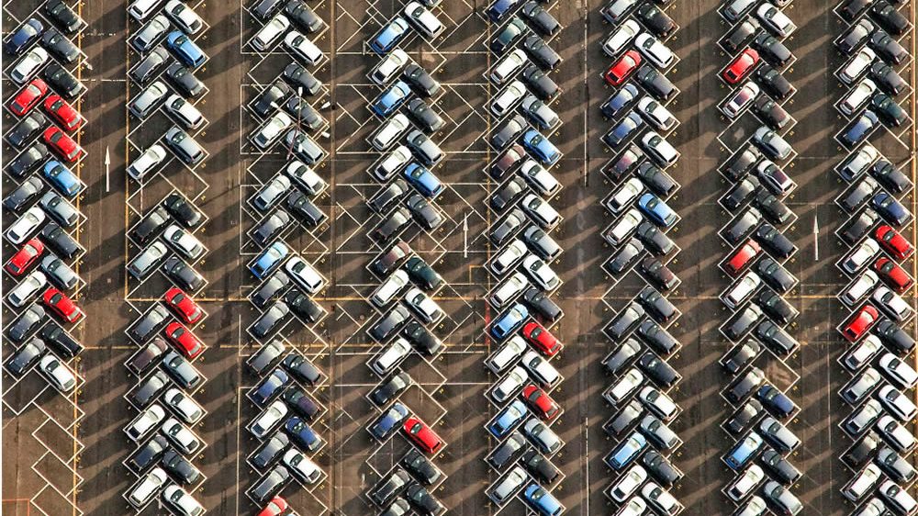
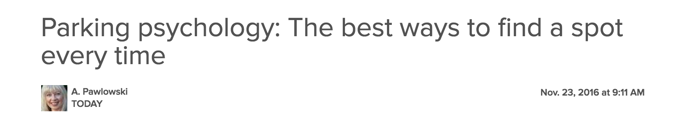
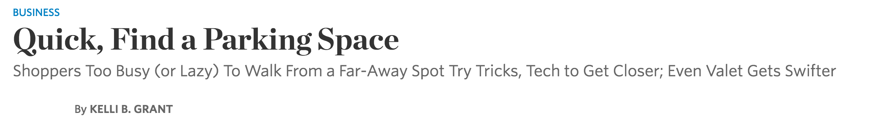
Problem
Finding an open spot in a crowded parking lot is frustrating and time consuming
For certain businesses, this problem is seemingly unavoidable
Sports venues are usually downtown and have limited space for parking. Their parking lots will always be partially or completely full on game days
Airports need to have space for hundreds or even thousands of cars. If the airport is busy, travelers need to search these massive lots for an open spot
There is an obvious need to solve this problem
Respected news sources use print space on articles related solely to parking spots and how to find them. This means readers must be interested

Slide 3
Problem
A Common Solution - Install a system which knows every possible parking space, and has hardware which keeps track of which spaces are available
Very Expensive – Buying and installing sensors costs a lost of money. Works for hospitals, malls, etc.
An Uncommon Problem – What if parking lots are not used often, but every time they are used, they are incredibly crowded.
A venue during an event (e.g. Notre Dame parking on game day)
Airport parking on Thanksgiving
Non-traditional parking such as parking in fields for festivals and other large events
The common solution is too expensive to be a viable option
ParkByDrone
An Uncommon Solution…

Slide 4
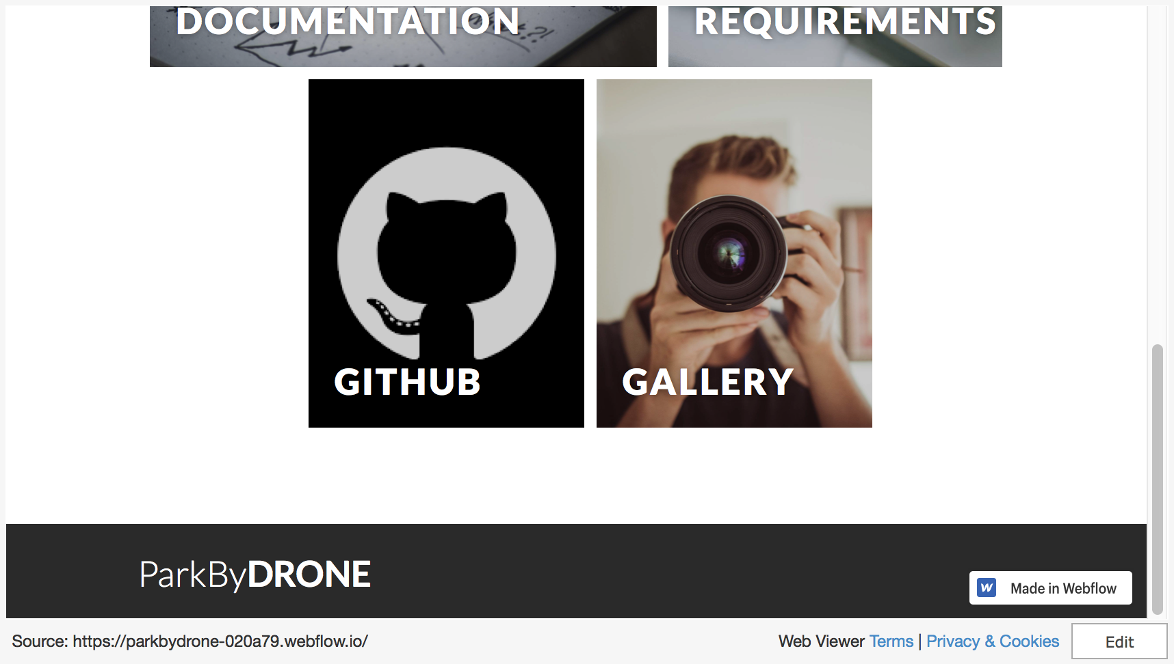

Slide 5
How it Works
In Theory
Potential Parking Spots are marked
The Drone Flies to the Location
The Drone Take an Image of the Lot
The Drone Identifies the Location of an Open Spot
The Drone flies to the Open Spot
In Practice
The flying field has to be prepped by laying a large blue circle down somewhere.
The location of the flying-field is preprogrammed into the drone. The drone is activated directly via keyboard
The drone takes off, flies above the flying field, and takes a picture
This picture is processed, and the location of the blue circle in the image is identified. The pixel address of the center of this “open spot” is returned.
The drone uses it’s current location and the pixel address to calculate where to fly
The drone flies to this location, hovers for a short period of time, then returns to base

Slide 6
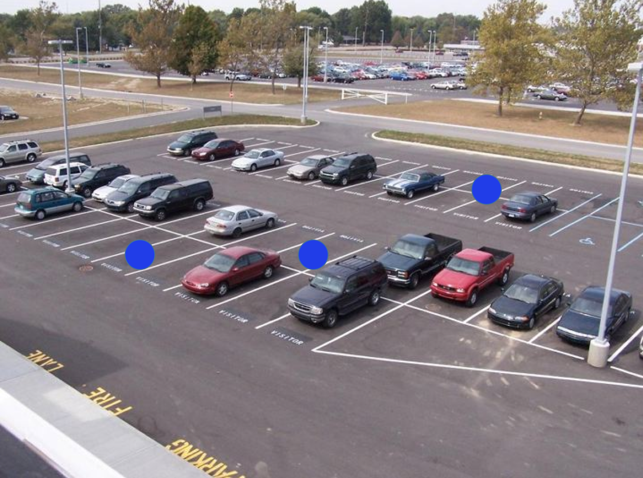
Potential Parking Spots are Marked
How it Works
Potential Parking Spots are marked
The Drone Flies to the Location
rzf
rzf
rzf
Three potential spots “marked” here
Can either be a permanent painted shape, or a cheap piece of plastic that is laid down. Either way, very inexpensive.

Slide 7
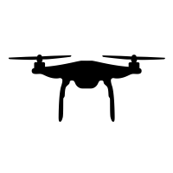
The Drone Flies to the Location
How it Works
Potential Parking Spots are marked
The Drone Flies to the Location
Drone
Destination: Parking Lot
Property Area
rzf
rzf
Can either be a permanent painted shape, or a cheap piece of plastic that is laid down. Either way, very inexpensive.

Slide 8
The Drone Takes an Image of the Lot
How it Works
Potential Parking Spots are marked
The Drone Flies to the Location
The Drone Take an Image of the Lot
Image is taken with a GoPro camera, and passed to the drone via a wireless signal from the GoPro

Slide 9
The Drone Identifies the Location of an Open Spot
How it Works
Potential Parking Spots are marked
The Drone Flies to the Location
The Drone Take an Image of the Lot
The Drone Identifies the Location of an Open Spot
1. Get Location in the Image (pixel,pixel)
2. Calculate Actual Location (Lat,Lon)
The Drone first processes the image, then finds the blue circle in the result, then uses the location of the circle to calculate actual coordinates

Slide 10
The Drone Flies to an Open Spot
How it Works
Potential Parking Spots are marked
The Drone Flies to the Location
The Drone Takes an Image of the Lot
The Drone Identifies the Location of an Open Spot
The Drone Flies to the Open Spot
The drone will remain above the spot until it is filled or a specified amount of time has passed

Slide 11
Why ParkByDrone is Pretty Cool
Implementation…... Practical Impact
Drone is not controlled remotely
Object-Oriented Design keeps all image code separate from drone code
Hardware Architecture relies on popular products that communicate with each other
Does not require any on-site hardware
Very low overhead associated with “breaking down” and “setting back up” the system.
Scalability is easy. Just change how drone moves, image code is unchanged.
Easy to find existing codes and methods
Very low cost of testing because each individual product is tested independently
Safety testing easier for same reason

Slide 12

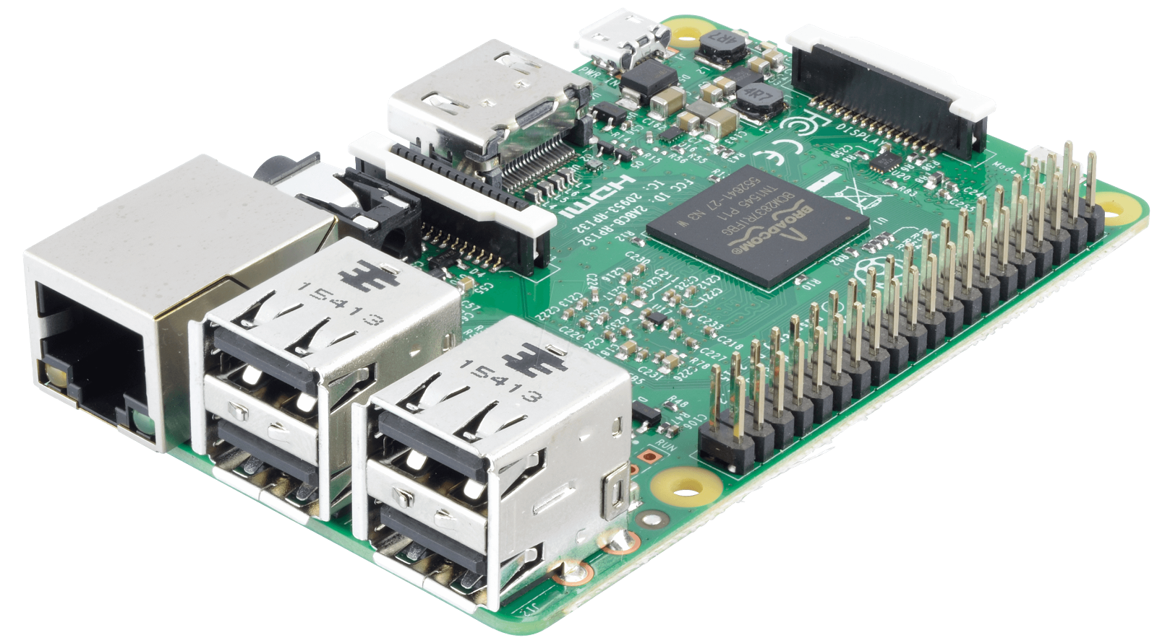
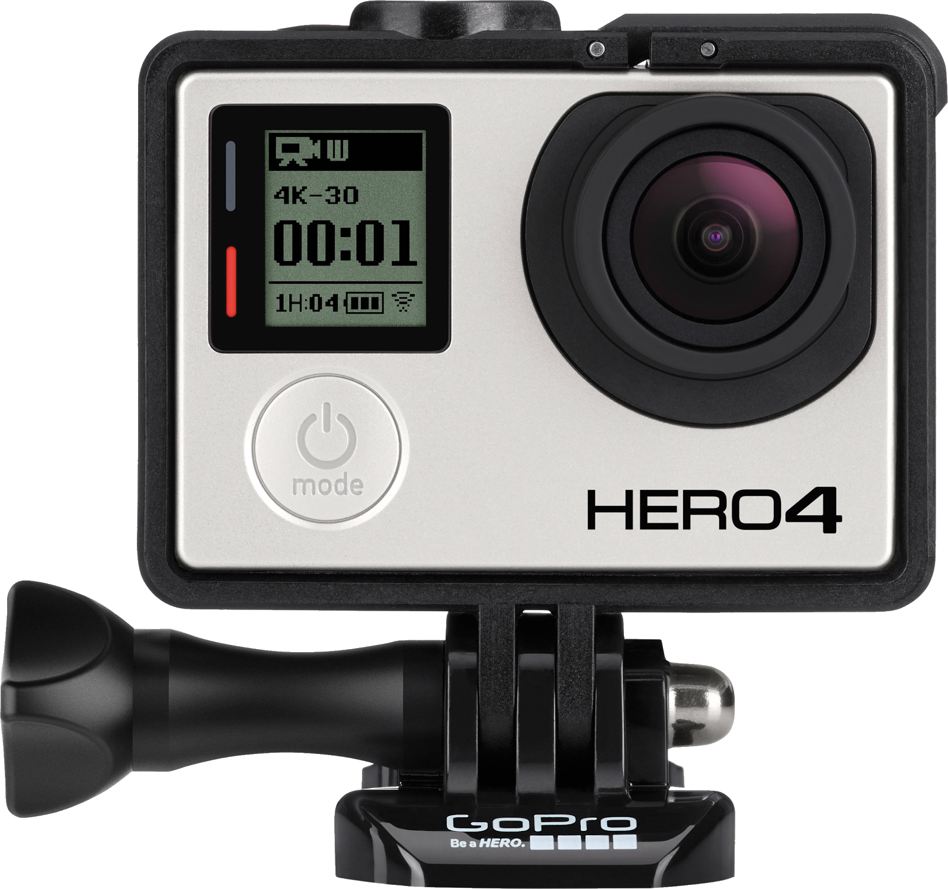
Architecture
Drone
Send Coordinates
Raspberry Pi
Get Location
Request Picture
GoPro
Get Picture

Slide 13
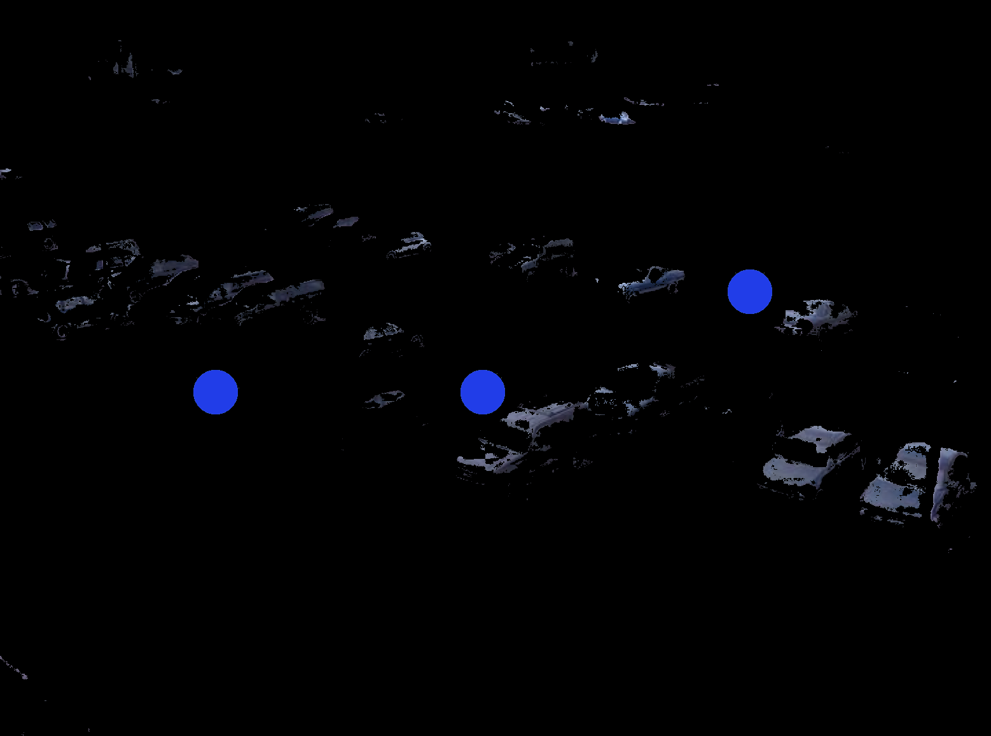
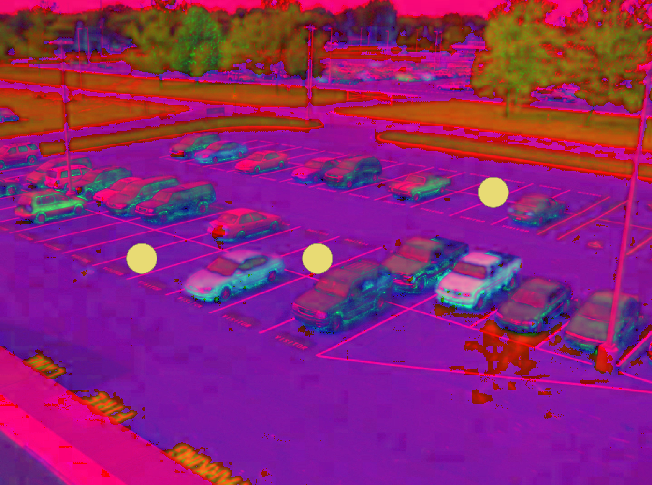
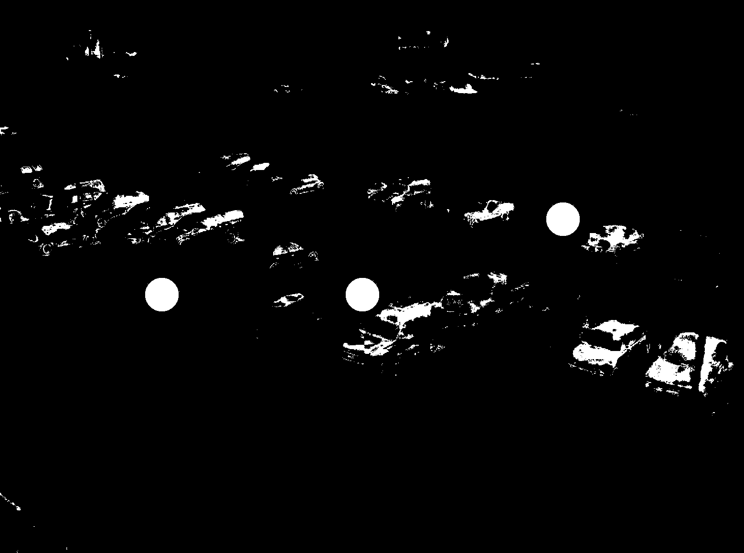
Image Processing
3. Mask overlaid with image
1. Raw Image Converted
to HSV
2. Binary mask image
Generate from given color range

